Slide 1



Trees And Forests
Steve Mitchell

Slide 2
Agenda
Decision Trees
Random Forests
Ensemble Models
Python Demo

Slide 3
Decision Trees

Slide 4
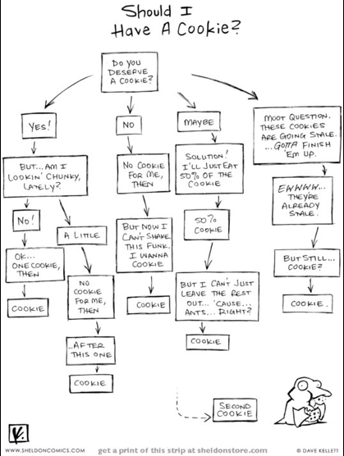
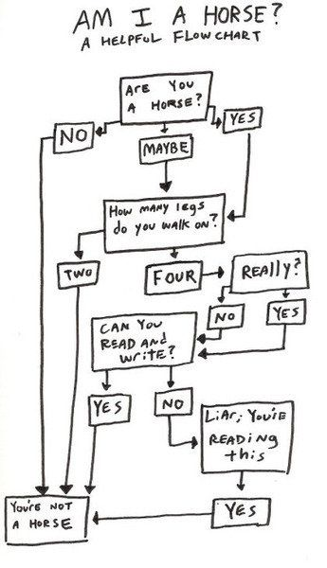
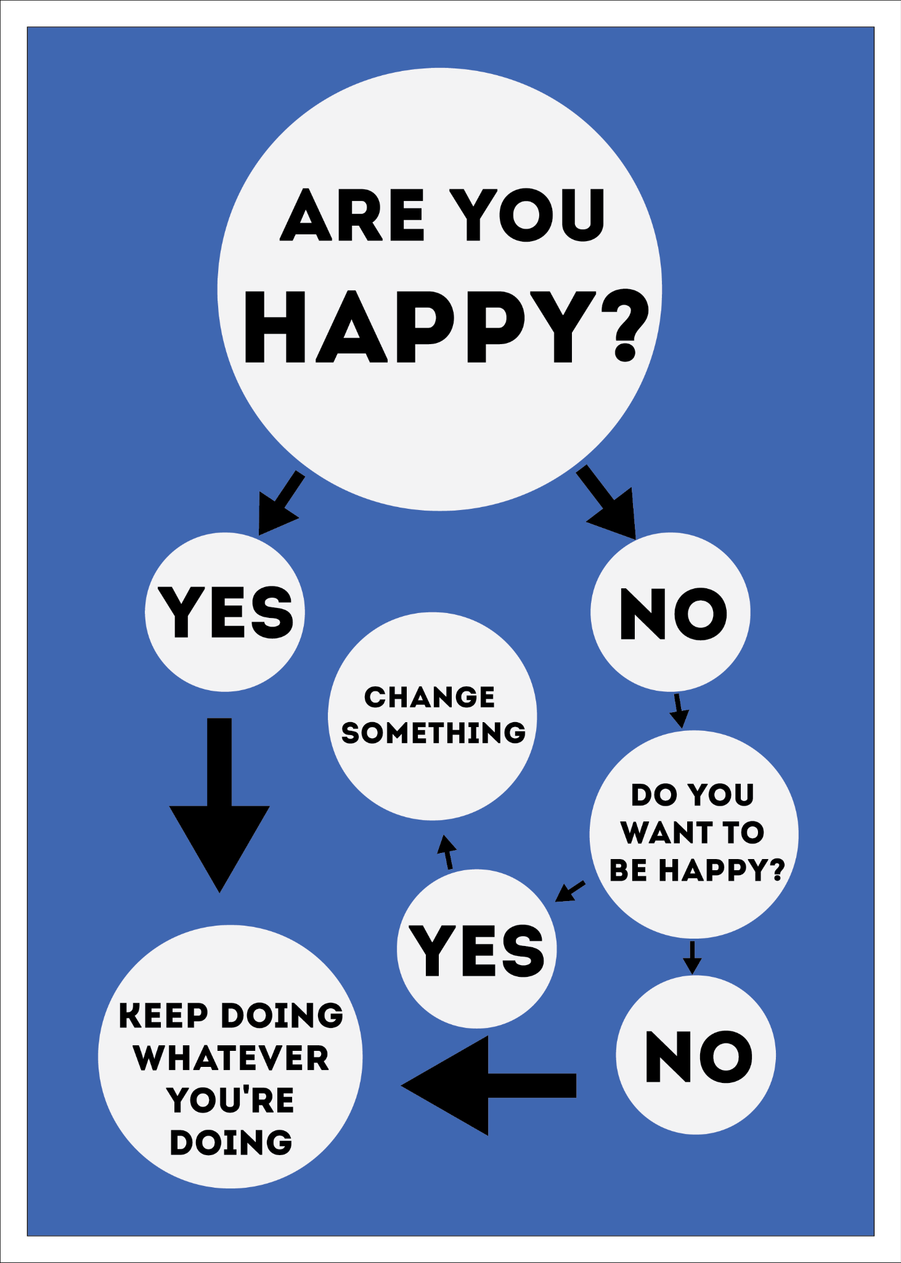
Decision Trees

Slide 5
Decision Trees
Flow chart based on features
Branches connect nodes:
Root
Internal
Leaf
Tree Depth = number of levels
Classification / Regression
Feathers?
YES
NO
Can fly?
Finns?
YES
NO
YES
NO
Hawk
Penguin
Dolphin
Bear

Slide 6
Decision Trees
Feathers?
Finns?
Can fly?
Hawk
YES
NO
YES
Penguin
YES
YES
NO
Dolphin
NO
YES
NO
Bear
NO
NO
NO

Slide 7
Classification Trees
Xa < Xa₁
4
YES
NO
Xb₂
2
Xb < Xb₁
Xa < Xa₂
Xb
3
YES
NO
YES
NO
5
Xb₁
1
2
3
Xb > Xb₂
1
YES
NO
Xa₁
Xa₂
4
5
Xa
Notes:
Splitting to minimize impurity
E.g. Gini index

Slide 8
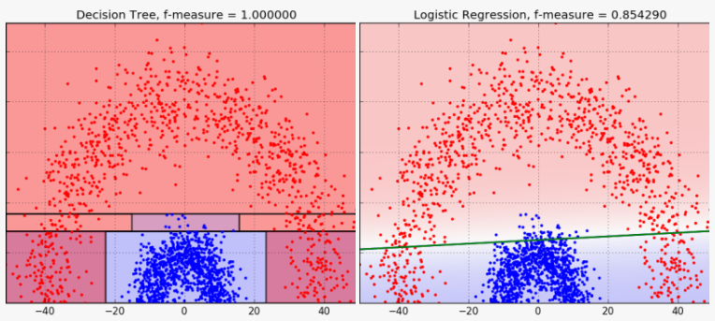
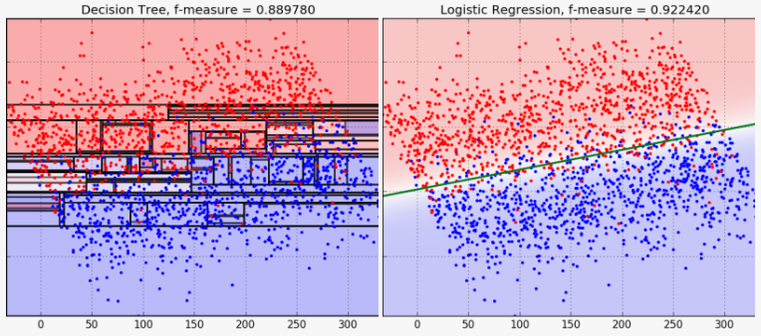
Classification Trees
Logistic regression: single decision boundary line
Classification tree: regions in the feature space

Slide 9
Regression Trees
X < X₂
YES
NO
Y
X < X₁
X < X₃
YES
NO
YES
NO
Y=3.50
Y=15.25
Y=23.75
Y=3.75
X₁
X₂
X₃
X
Notes:
Splitting to minimize error
E.g. RSS

Slide 10
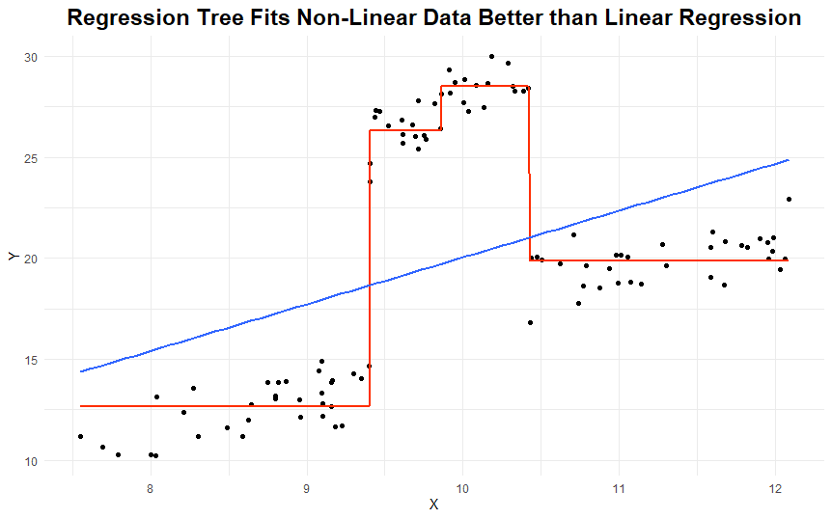
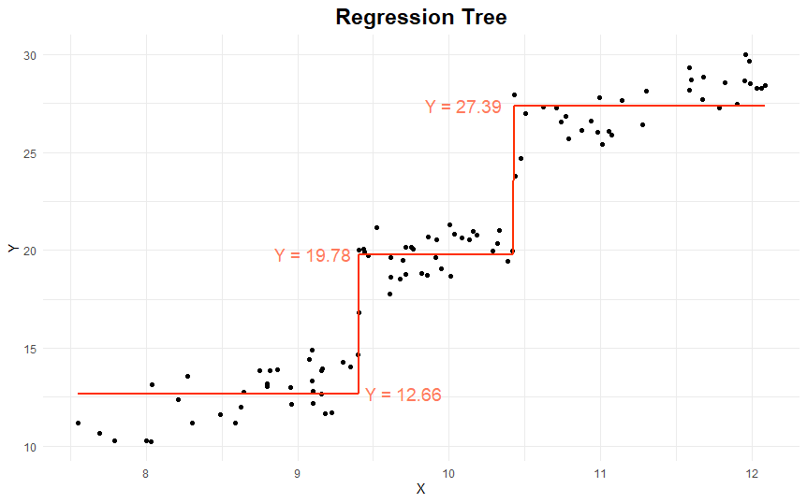
Regression Trees
Linear regression: straight line
Regression tree: mean value across each leaf

Slide 11
Decision Trees
Simple to understand and interpret
Can be visualized
Requires little data preparation (scaling not necessary)
Can handle multi-class classification well
Tendency to overfit
Can be unstable (small change to data may result in a completely different tree)
Each node is locally optimized (not globally)

Slide 12
Random Forests

Slide 13

Random Forests
A tree with a high depth is likely to be overfit
Solution: put many trees together into a “forest”
Each tree is based on a random resampling of the original data (bootstrap)

Slide 14
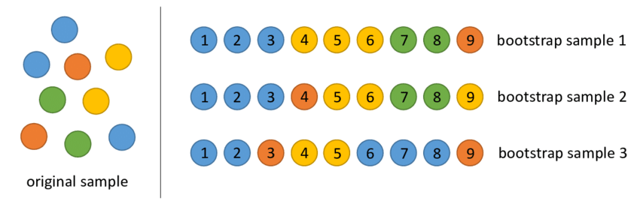
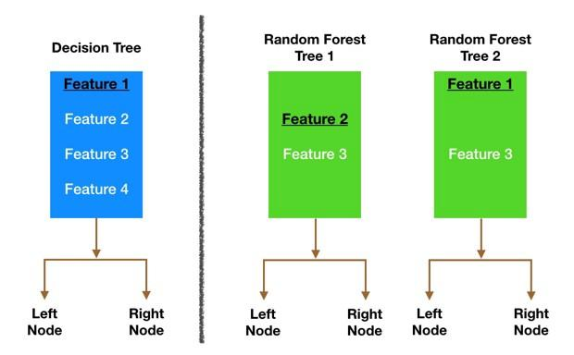
Random Forests
Bootstrapping: random resampling with replacement
Features also randomly sampled (often sqrt(n_features) per tree
Results in a number of overfit trees
Predictions are averaged

Slide 15
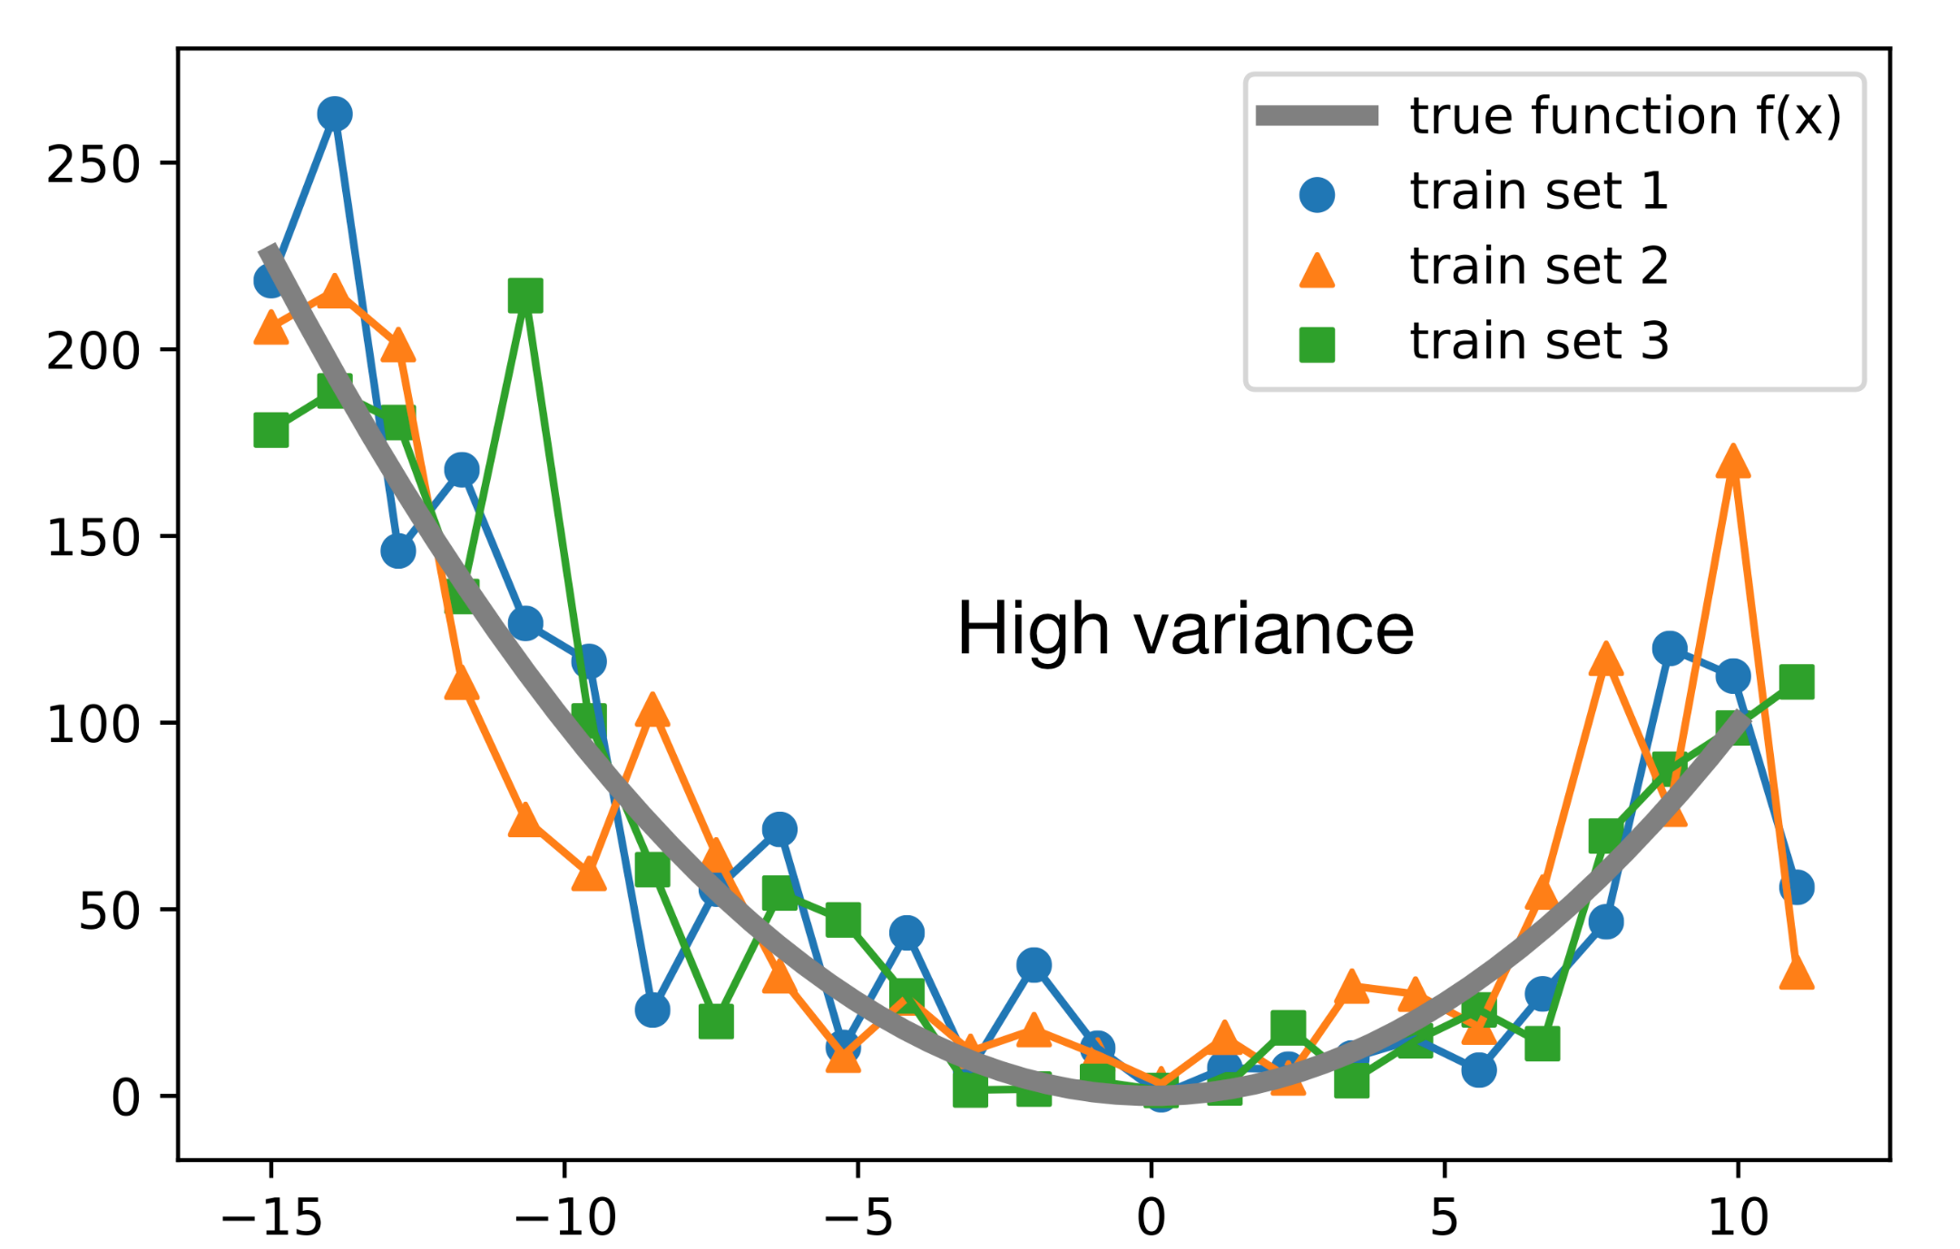
Random Forests
Notes:
Averaging many over-fitted models reduces variance.

Slide 16
Random Forests
Usually more accurate than Decision Trees
Usually among top-performing classifiers
Less prone to overfitting than Decision Trees
Typically slower than Decision Trees
Interpretation is often challenging

Slide 17
Ensemble Methods

Slide 18
Ensemble Methods
Combining multiple weaker models to produce improved results
Bagging: same base model on bootstrapped data, all trained in parallel, tackles overfitting
Boosting: training in sequence, errors passed to each successor, tackles underfitting
Stacking: variety of weak models as input to a “meta-model”, trained in parallel, aggregation after training
Notes:
Ask which one is Random Forests

Slide 19
Ensemble Methods
Training in sequence?
YES
NO
Boosting
Homogenous model?
YES
NO
Bagging
Stacking
Notes:
Ask which one is Random Forests

